Slide 1




COM 597: Interactive Design
Mobile APP Project
Christine Liu ．Edward Chang ．Li-Tien Ou ．Melinda Yang

Slide 2

Project Goal
Increase
Walk-in
Rates
Go Viral
with
Social Media
Brand
Favorability
CarMax
Users
Uniqueness
Experience
Entertaining
Process
Make Car-picking
Process Easier
Notes:
Craft a two paragraph description of your concept and how it will benefit CarMax and its users. The format should follow:
What the user(s) want
What the org wants
How you will make both successful

Slide 3
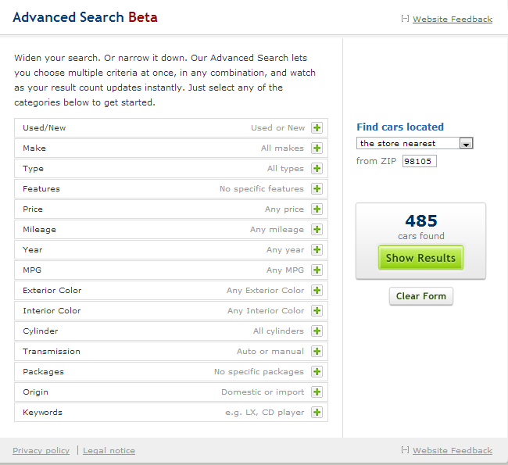




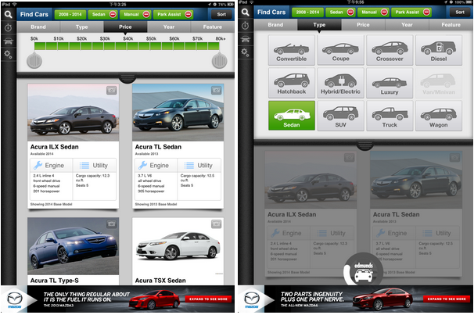
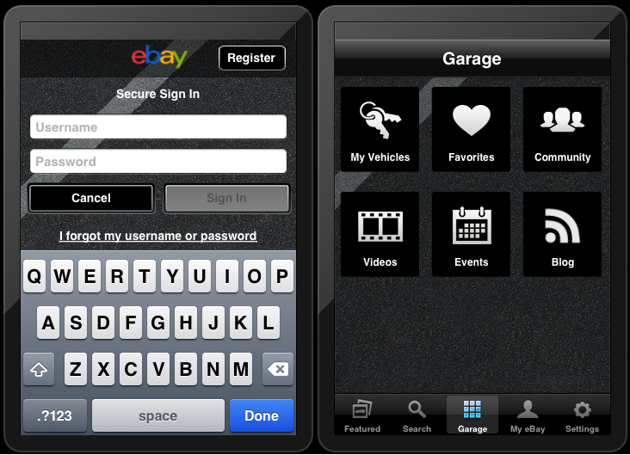
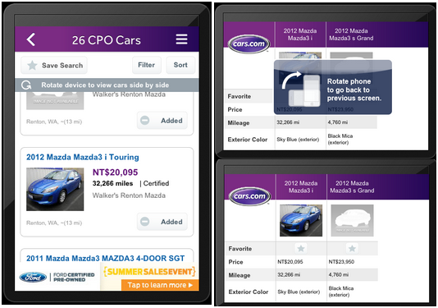
Research Findings: Best Practices Competitive Audit
Features | Point out valuable cars | Compare up to three options at a time side by side by rotating device | Need ebay account to save cars Has various channels for additional car information | Need to follow three steps to complete searching by brand -> series -> year
Functions | 1. Car search 2. Sell cars 3. Favorites 4. Research 5. Financing | 1. Superior searching results 2. Research & specs 3. Favorites 4. Tools 5. Dealers & reviews | 1. Featured cars 2. search 3. Favorites 4. Community, video, blogs, events | 1. vehicle search 2. dealer search 3. calculators 4. Show available cars with nearby dealers 5. Professional and user reviews
UI | 1. Filter is complicated 2. Inconsistency UI and aesthetic design | 1. Color organization displays consistency of organization 2. Memory for color information | 1. Simple and 2. Elegant UI design | 1. Offer user control and freedom 2. Search options minimize users' memory load
Notes:
Competitive Best Practices Audit
As a team, evaluate what you see as good executions of tools that assist users in making a large decision. This evaluation of a competitor or set of competitors is to help you refine your scope, functionality and approach for your final project.
Evaluate first the Recommendation tool found within the Research section of the Carmax website. Capture anything you see as good ideas to follow through with your concept.
Review competitor sites or similar tools to the one you are concepting.
Write a one to two sentence description of what are good ideas, well executed or unique UI concepts for each of the features you evaluate.
Make sure to use screen shots in your assessments. You will be discussing your findings as a group in class, so make sure you are prepared to finalize your thoughts around your project concept.

Slide 4





Research Findings: Interviews
The distrust feeling toward dealers
Would love to get recommendations from friends
Hard to calculate the ideal car meeting budget
Complexity of filtering searching results
Have difficulty managing the list of cars
they were interested in

Slide 5


How the interview affected our final app
1. Create entertaining process by gamification
2. Provide favorite function
to keep interested cars in a list
3. Find or contact dealers easily
4. Intuitive filter function
5. Clear list of price and features
based on location

Slide 6



Concept & UX Strategy
Gathering FB
Personal Information
Give Recommendations
like a friend
Define Persona
GET YOUR MATCHED CARS!

Slide 7
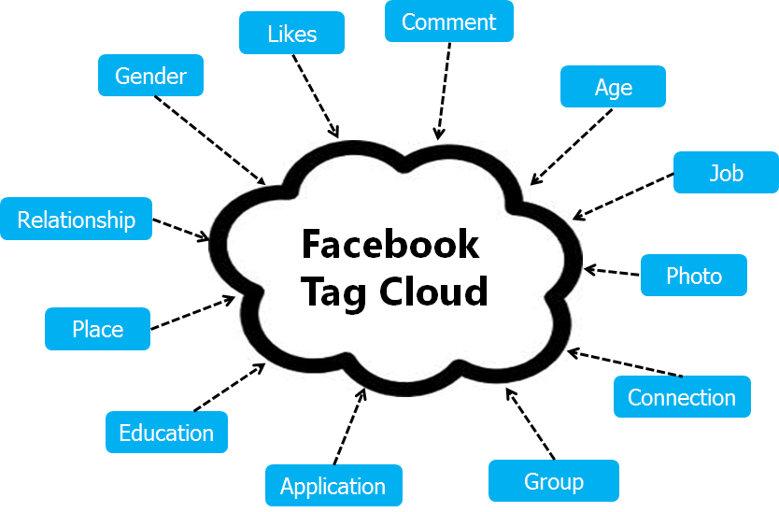
Concept & UX Strategy

Slide 8
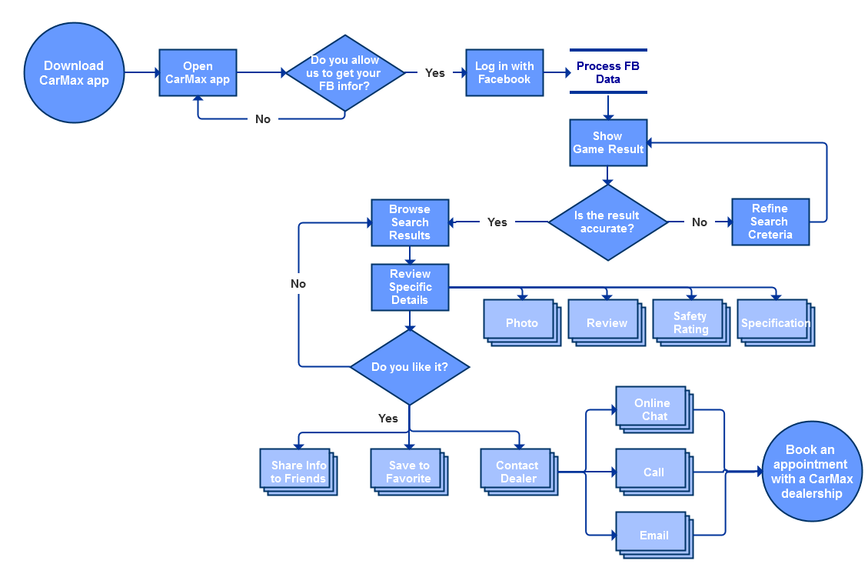
User Flow
Notes:
User Flow
Provide a diagram flow showing the main steps of your tool and the user prompts and system outputs for each step. The flow should exactly match your final wireframes.
Follow the user flow convention for symbols used on the user flow assignment (sample attached)
Use the diagram to assist you in solving ways to minimize the number of steps and options required of the user to complete the tasks.
The entry point is the user either downloading a CarMax app for their mobile device or accessing a mobile friendly tool from the CarMax site.
The final point is the user booking an appointment with a CarMax dealership

Slide 9
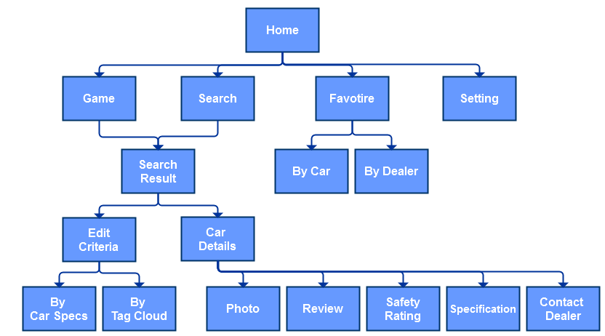
Sitemap
Sitemap

Slide 10
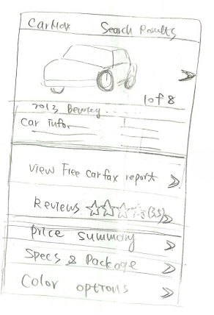
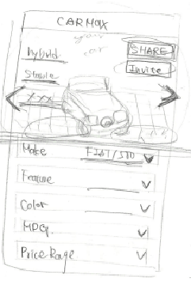
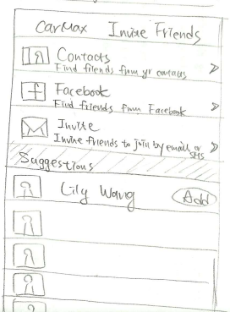
Sketches
Notes:
需補上其他sketches

Slide 11
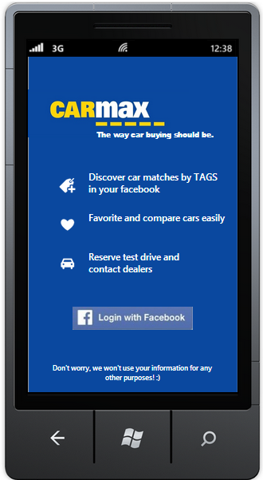
Wireframe
Entry into the tool
Process of gathering users' FB data
Start the game and get recommendations
Add favorite cars to a list
Contact a dealer about a specific car selected

Slide 12
Kirkland Life Chiropractic
T THANK YOU

